Slide 1
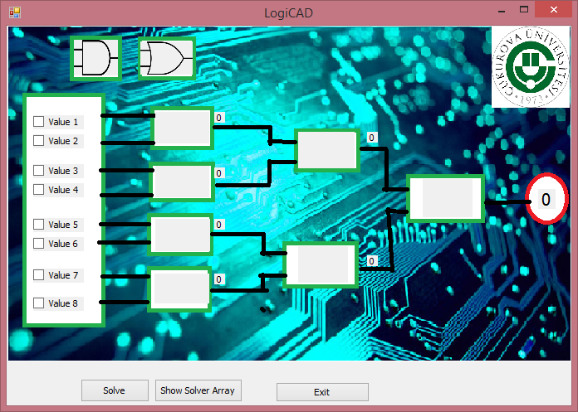
LogiCAD V0.1
Developing of an Open source algorithm to solve the n level logic circuits . And apply an example of it using c# Language .
BY : Fouad Asil 2012513301
Supervizer Asso.Prof.DF. Turgay ibrikci
2015

Slide 2
What are we going to see
Introduction
What is “Open Source”
The general Algorithm (Idea)
The solver Array
General Algorithm
Flow chart
Using The algorithm in specific case
discuss The Codes
How can it be Developed ??
References

Slide 3
Introduction
Computer aided design
Algorethms
Logic circuits
Never using pre-made classes !
Open source .
What I did exactly ???

Slide 4
Open source
According to Wikipedia : Open-source software (OSS) is computer software with its source code made available with a license in which the copyright holder provides the rights to study, change, and distribute the software to anyone and for any purpose.
Why its good for a course project

Slide 5
The general Algorithm
Combining windows Interface benefits with Array’s Calculations .
Easy to understand and able to develop to specific circuits solver (As I showed in V0.1)
Can handle the most simple and most complex circuits .
The main Idea is to convert the circuit to an array , with ability to easy input using the interface .
SPICE Language Inspired Me .

Slide 6
The solver Array
Solver Array For level n circuit :
Key | Level | 1st inp | 2nd inp | Type | Output
01 | n
02
…
2^n
11 | n-1
12
13
…
10 + 2^(n-1)
21 | n-2
22
23
…
20 + 2^(n-2)
…
…
…
n*10 + 2^0 | 1

Slide 7
Example for solver Array when N = 4 (series) after solution
Key | Level | 1st | 2nd | Type | output
1 | 4 | 0 | 0 | 0 | 1
2 | 4 | 0 | 0 | 0 | 0
3 | 4 | 0 | 0 | 0 | 1
4 | 4 | 0 | 0 | 0 | 0
5 | 4 | 0 | 0 | 0 | 1
6 | 4 | 0 | 0 | 0 | 0
7 | 4 | 0 | 0 | 0 | 1
8 | 4 | 0 | 0 | 0 | 0
11 | 3 | 1 | 0 | 1 | 0
12 | 3 | 1 | 0 | 0 | 1
13 | 3 | 1 | 0 | 0 | 1
14 | 3 | 1 | 0 | 1 | 0
21 | 2 | 0 | 1 | 0 | 1
22 | 2 | 1 | 0 | 1 | 0
31 | 1 | 1 | 0 | 0 | 1

Slide 8
General Algorithm
Recognize inputs (code and interface)
Read Inputs
Make calculations for last level
Use it to solve n-i level …
Show the output

Slide 9
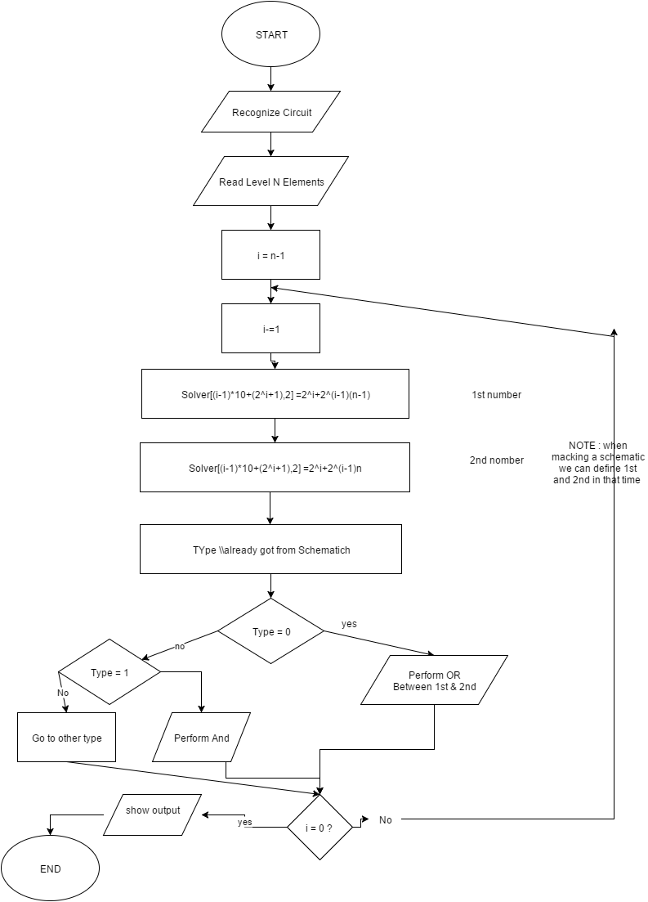
Flow chart

Slide 10
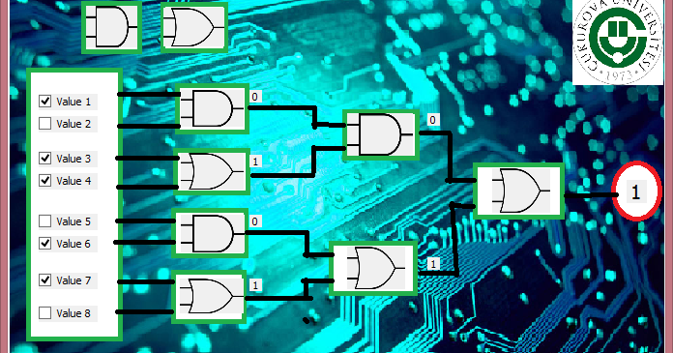
Using The algorithm in specific case
Why is it good to make sub-progs to solve special circuits ?
Expline our Case (series)
Drog and drop is fun !

Slide 11
Lets discuss The Codes !!!
Short Visit for the source Code !

Slide 12
How can it be Developed ??
Add a special Gates ! (even pre designed) .
The ability to Draw the schematic (How Can we do It ?)
Connect the inputs and the output outside ! (applications of that ! )
Dealing with Errors .
Active Helper !
This could be made by Anyone !

Slide 13
Publish the open source
Its the last step !
Some sites :
https://developers.google.com/open-source/projects?hl=en
http://sourceforge.net/
https://opensource.com

Slide 14
Lets solve an 4 levels Series And or logic circuit .
Run The Program .

Slide 15
References
msdn.microsoft.com
stackoverflow.com
www.codeproject.com
Wilipedia.com
Our Lectures Notes

Slide 16


We Done !
Any Questions ????

